Slide 1
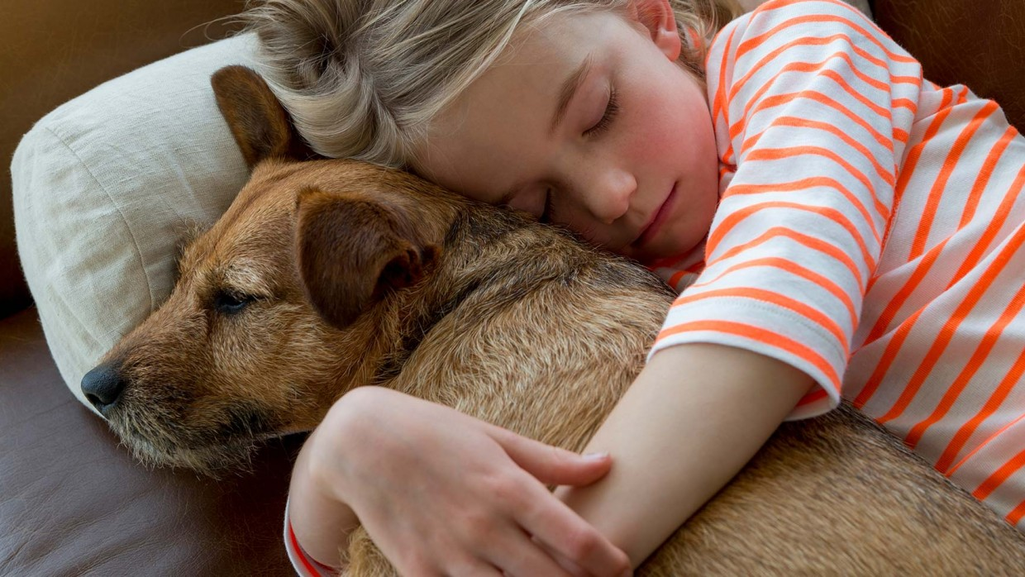
Mission: Match-A-Pet
Team: Deus Ex-Machina (God of Tech)
Product Owner: Shruti Agarwal
Scrum Master: Gururaj Shinde
Sprint Demo:
Let’s Code!

Slide 2
Sprint Goals:
Link to Zenhub
Landing Page
Shelter Registration

Slide 3
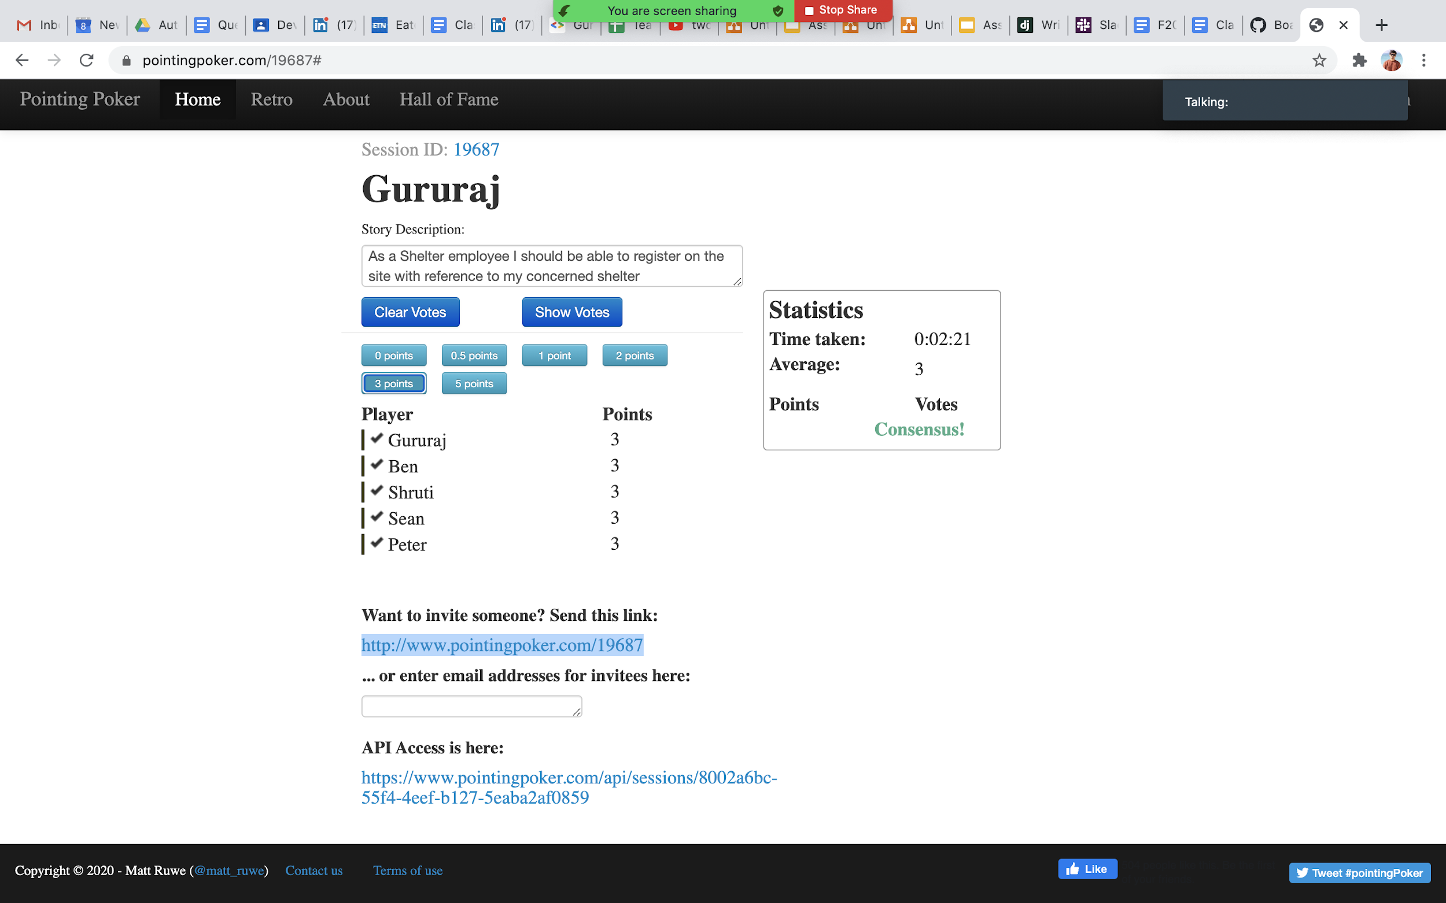
Sprint Forecast:

Slide 4
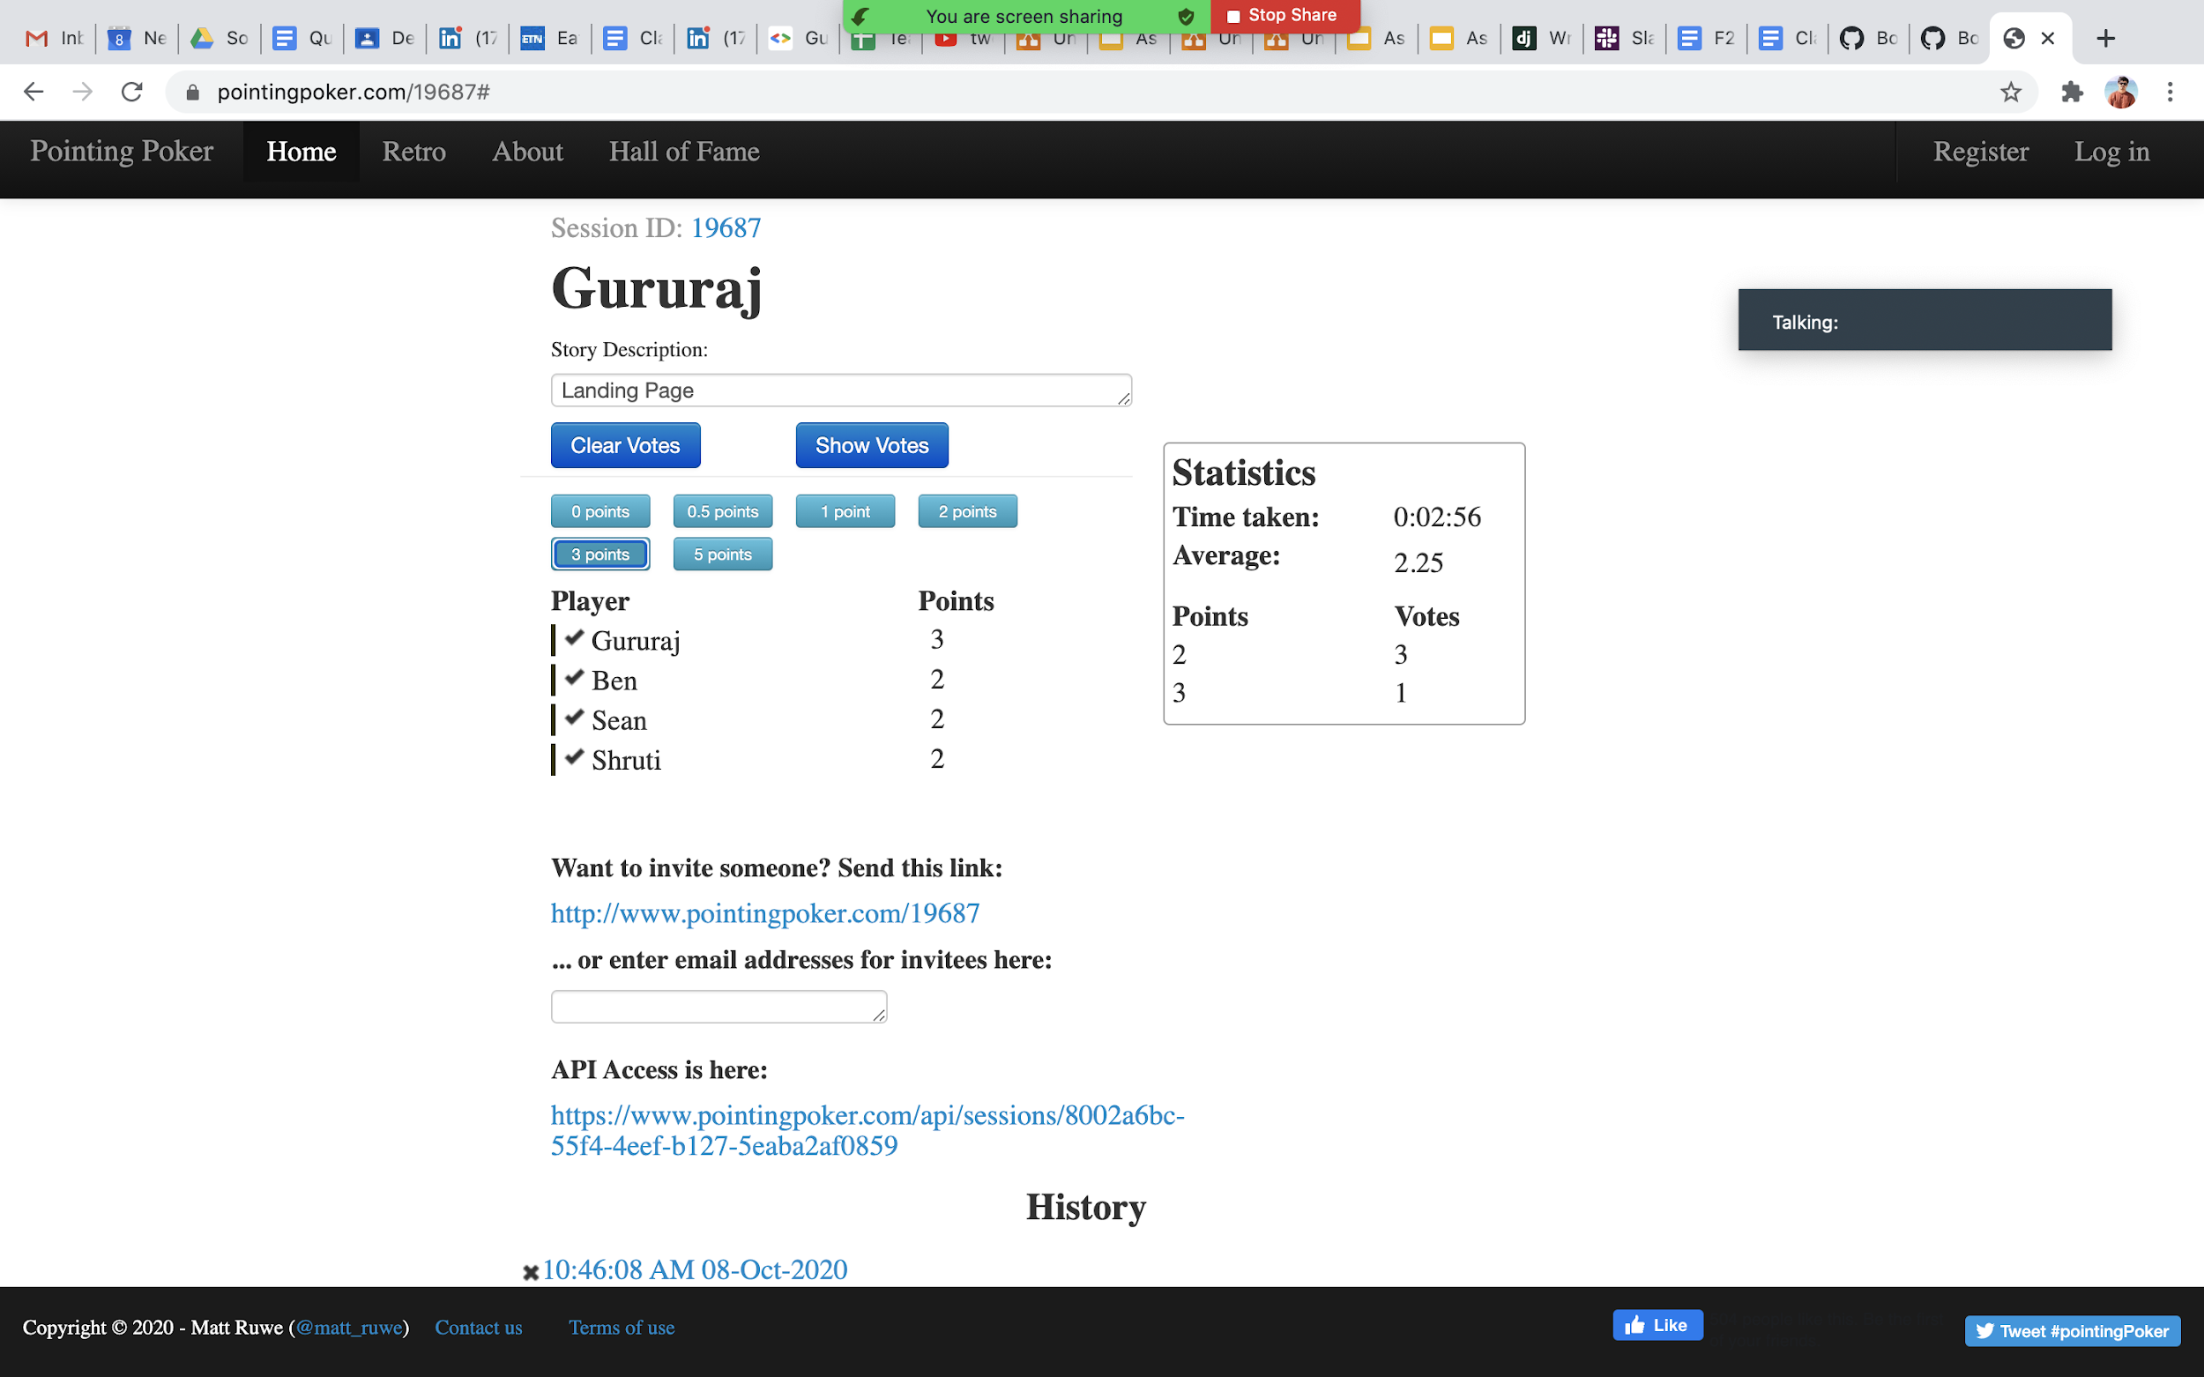

Slide 5
ER Diagram:
MESSAGE / INQUIRY
MessageID
Message Sender ID
Message Receiver ID
Message Time Date
Message Text
USER
UserID
Username
User Email
User Real Name
User Password
User City
User ZipCode
Sends
PET
PetID
Pet Name
Pet Breed
Pet Age
Pet Color
Pet Gender
ShelterID*
Date Entered Shelter
Receives
Has
Receives
Sends
Registered To
USER PET PREFERENCE
Pet Preference ID
Username
Breed
Color
Age
ZipCode
UserID*
SHELTER
ShelterID
Shelter Email
Shelter Name
Shelter Password
Shelter Zip Code
Shelter City
Shelter State
PET POST
PostID
Post Time Date
Post Text
PetID*
Posts

Slide 6
Demo:
Staging : https://match-a-pet-staging.herokuapp.com/
Production : https://match--a--pet.herokuapp.com/
Wiki: How to use Github, deploy to stage, prod

Slide 7
Lessons Learned:
Working together in sub teams helped us achieve this in a much faster and efficient way
Self designed websites always win over online templates, but they provide a good base
Using a base.html will help us avoid repetitive code
It is a good idea to dedicate an amount of time for Team Bonding, therefore, Happy Hour!

Slide 8
Retrospective Report:
Retrospective Report

Slide 9
Thank you

